Slide 1
21MHE521J Industrial Manipulators – Kinematics, Dynamics and Control
Course Instructor
Dr A Vimala Starbino
Assistant Professor
Department of Mechatronics Engineering
SRM Institute of Science and Technology
Kattankulathur

Slide 2
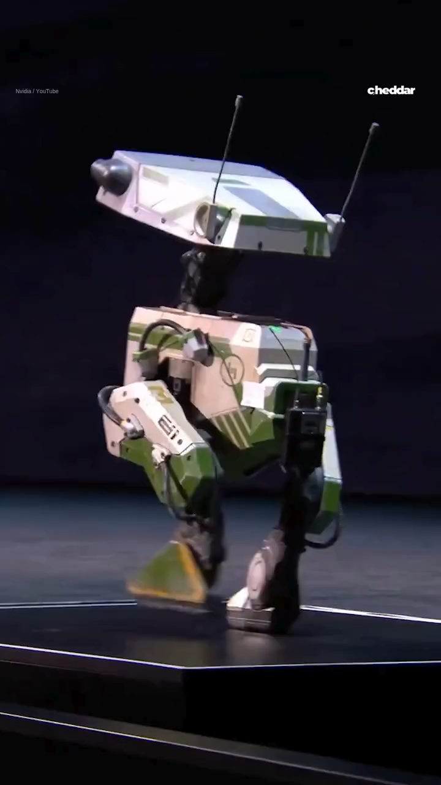

Slide 3
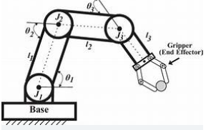
In robotics, a manipulator is basically the mechanical arm of a robot — the part that moves and interacts with objects in the environment.
Links → the rigid segments (like bones)
Joints → the movable connections between links (like elbows or wrists)
End-effector → the “tool” at the tip (like a gripper, welding torch, or drill) that actually does the work
A manipulator’s job is to position and orient its end-effector in the right place so it can perform tasks such as picking up objects, welding, assembling parts, or even doing surgery.
In engineering terms, it’s defined as:
A device composed of links and joints, capable of moving and positioning an end-effector to perform specific tasks.

Slide 4
Aspect | Manipulator | Robotics
Definition | A mechanical arm or device used to handle objects by moving, lifting, or positioning them. | The interdisciplinary field involving the design, construction, programming, and control of robots.
Scope | Part of a robot (focuses on the physical arm mechanism). | Covers the whole robot system, including manipulator, sensors, actuators, controllers, and software.
Function | Moves and positions the end-effector to perform tasks like welding, painting, or picking objects. | Integrates sensing, decision-making, and action to perform autonomous or semi-autonomous tasks.
Control | Usually controlled through joint angles, trajectories, and motion planning. | Involves control of manipulators, mobile bases, sensors, and software for complete task execution.
Example | The robotic arm in an assembly line. | An autonomous warehouse robot that navigates, detects items, and picks them up with its manipulator.

Slide 5
Module-1 – Introduction to Manipulator Robotics and Transformations 15 Hour
Basic terminologies in robotics, Anatomy of Robot , Basic configuration based on work volume, Description of point and body in space, Representing translation of body, Representing rotation of a body
– Rotation matrix, Euler angle representation, Quaternions , Homogenous transformations, Importance of Transformations in Robotics – Mapping (Frame to frame) and operators, Numerical on
transformations
Lab 1: Basics of Linear algebra and vector transformations
Lab 2: Introduction to spatial transformations
Module-2 – Introduction to Kinematics 15 Hour
Definition of Kinematics – Forward and Inverse Kinematics, Introduction to manipulator forward kinematics – Geometric and analytical method, Example of geometric method – 2R palanar and 3R spatial
manipulator, Introduction to standard DH convention, DH matrix and transformation, Forward kinematics computation using standard DH – 2R manipulator, 3R spatial manipulator, RPY wrist, Introduction
to Inverse kinematics and application, Inverse Kinematic computation: Closed form solution, conditions and steps in computation, Inverse kinematics computation using standard DH – 2R manipulator,
3R spatial manipulator, RPY wrist, Application of Inverse kinematics and transformations for a general pick and place application
Lab 3: Simulation of Forward kinematics model
Lab 4: Simulation of inverse kinematic model

Slide 6
Module-3 – Differential Kinematics and Trajectory Planning 15 Hour
Introduction to Differential kinematics – Jacobian matrix and mapping, Velocity representations (Linear and angular velocity) and transformations – multi DoF rigid body, Steps in the computation of Jacobian matrix for multi DoF manipulators, Jacobian computation – 2R planar, 3R spatial and RPY wrist, Concept of singularity and its consequence, Computing singularity conditions for manipulators - 2R planar, 3R spatial and RPY wrist (Wrist singularity), Introduction to trajectory planning and its importance, Joint space trajectory planning (cubic polynomial and trapezoidal), Cartesian space trajectory planning.
Lab 5: Velocity kinematics model and singularity simulation
Lab 6: Trajectory planning
Module-4 – Introduction to Manipulator Dynamics 15 Hour
Concept of Dynamics – Forward and Inverse dynamics, Dynamics computation method- Newton Euler (example of 2R planar manipulator), Recursive dynamics, Lagrangian method (example of 2R planar manipulator), Dynamics of 1R,and 3R spatial arm, Dynamics of pendulum over cart (transfer function and state space model) and its importance in control
Lab 7: Dynamics simulation I
Lab 8: Dynamics simulation- II
Module-5 – Manipulator Control 15 Hour
Introduction to joint and cartesian control, Position and velocity control (P,PI and PID), Properties of PID control and tuning, Concept of partition control, Computed torque control, Introduction to force control, Hybrid force -position control and its control architecture, Concept of natural and artificial constraints, Example of Peg in Hole assembly
Lab 9: Closed loop control- PID
Lab 10: Computed torque control- Simulation

Slide 7
Robot Components
A robot, as a system, consists of the following elements, which are integrated together to form a whole:
Manipulator or the rover: This is the main body of the robot which consists of the links, the joints, and other structural elements of the robot. Without other elements, the manipulator alone is not a robot
End effector: This part is connected to the last joint (hand) of a manipulator that generally handles objects, makes connections to other machines, or performs the required tasks. Robot manufacturers generally do not design or sell end effectors. In most cases, all they supply is a simple gripper.
Actuators: Actuators are the ‘‘muscles’’ of the manipulators. The controller sends signals to the actuators, which, in turn, move the robot joints and links. Common types are servomotors, stepper motors, pneumatic actuators, and hydraulic actuators. Actuators are under the control of the controller.
Sensors: Sensors are used to collect information about the internal state of the robot or to communicate with the outside environment. As in humans, the robot controller needs to know the location of each link of the robot in order to know the robot’s configuration. When you wake up in the morning, even without opening your eyes, or when it is completely dark, you still know where your arms and legs are. This is because feedback sensors in your central nervous system embedded in muscle tendons send information to the brain. The brain uses this information to determine the length of your muscles and, consequently, the state of your arms, legs, and so on. The same is true for robots, where sensors integrated into the robot send information about each joint or link to the controller that determines the configuration of the robot. Still similar to your major senses of sight, touch, hearing, taste, and speech, robots are equipped with external sensory devices such as a vision system, touch and tactile sensors, speech synthesizer, and the like that enable the robot to communicate with the outside world.

Slide 8
Controller: The controller is rather similar to your cerebellum; although it does not have the power of the brain, it still controls your motions. The controller receives its data from the computer (the brain of the system), controls the motions of the actuators, and coordinates the motions with the sensory feedback information. Suppose that in order for the robot to pick up a part from a bin, it is necessary that its first joint be at 35 deg . If the joint is not already at this magnitude, the controller will send a signal to the actuator—a current to an electric motor, air to a pneumatic cylinder, or a signal to a hydraulic servo valve— causing it to move. It will then measure the change in the joint angle through the feedback sensor attached to the joint (a potentiometer, an encoder, etc.). When the joint reaches the desired value, the signal is stopped. In more sophisticated robots, the velocity and the force exerted by the robot are also controlled by the controller.
Processor: The processor is the brain of the robot. It calculates the motions of the robot’s joints, determines how much and how fast each joint must move to achieve the desired location and speeds, and oversees the coordinated actions of the controller and the sensors. The processor is generally a computer, which works like all other computers, but is dedicated to this purpose. It requires an operating system, programs, peripheral equipment like a monitor, and has the same limitations and capabilities. In some systems, the controller and the processor are integrated together into one unit. In others, they are separate units, and in some, although the controller is provided by the manufacturer, the processor is not; they expect the user to provide his or her processor.
Software: Three groups of software programs are used in a robot. One is the operating system that operates the processor. The second is the robotic software that calculates the necessary motions of each joint based on the kinematic equations of the robot. This information is sent to the controller. This software may be at many different levels, from machine language to sophisticated languages used by modern robots. The third group is the collection of application-oriented routines and programs developed to use the robot or its peripherals for specific tasks such as assembly, machine loading, material handling, and vision routines.

Slide 9
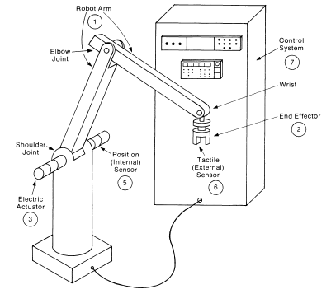

Slide 10
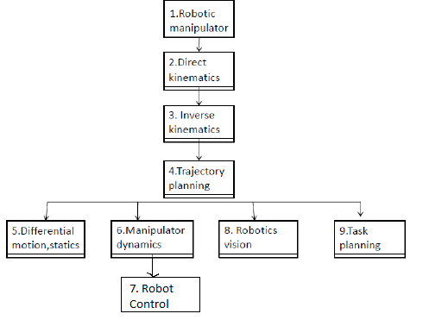
Robot Terminology

Slide 11
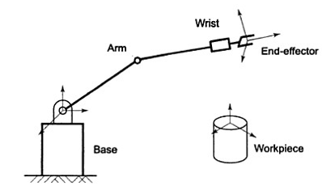
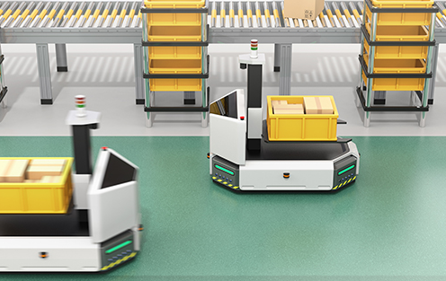
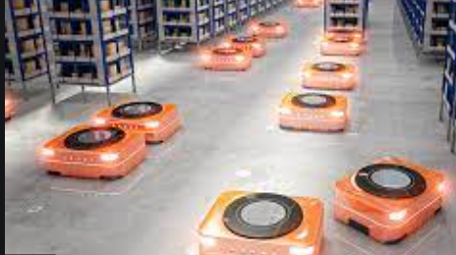
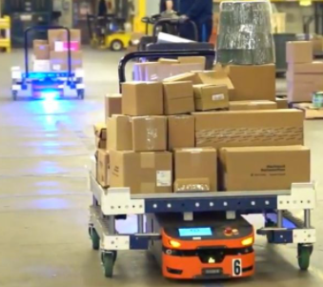
Robot Anatomy
Manipulator or Robotic arm has many similarities to the human body
Mechanical structure of a robot is like skeleton in human body
Robot Anatomy is therefore a study of skeleton of robot
i.e. physical construction of the manipulator structure
Mechanical structure consists of
Rigid bodies (links) connected by means of articulations (joints), is segmented into an arm that ensures mobility and reachability, a wrist that confers orientation and an end effector that performs the required task
Most manipulators are mounted on a base fastened to the floor or on the mobile platform of an autonomous guided vehicle (AGV)

Slide 12
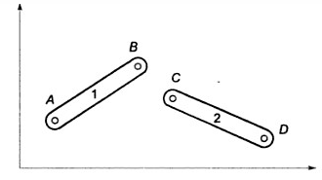
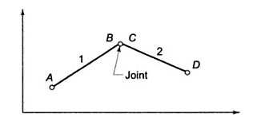
Links
Links are used to transmit mechanical power
Mechanical structure of a robotic manipulator is a mechanism whose members are rigid links or bars
Rigid link that can be connected at most with other two other links is referred to as a binary link
Two links are connected together by a joint
Links are represented by straight lines and rotary joint by a small circle

Slide 13
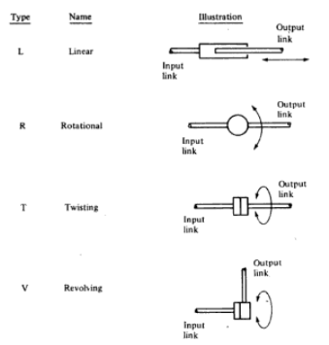
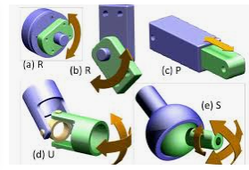
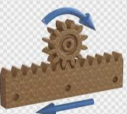
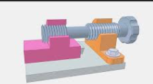
2. Joints and Joint Notation Scheme
Two basic types are commonly used in industrial robots
Revolute
Prismatic
Revolute Joint:
Two links are jointed by a pin (pivot) about the axis of which
the links can rotate with respect to each other
Prismatic Joint:
Two links are so jointed that these can slide (linearly move)
with respect to each other
Screw and nut, rack and pinion are ways to implement
prismatic joints

Slide 14
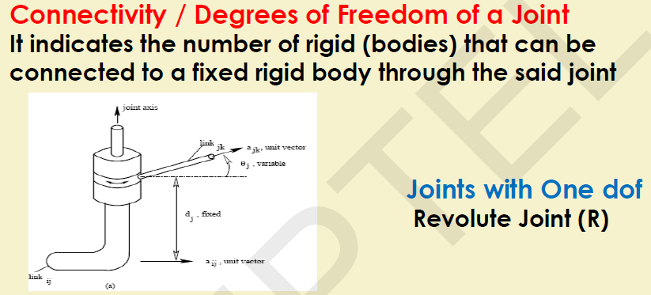
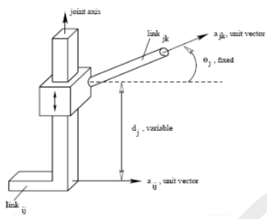

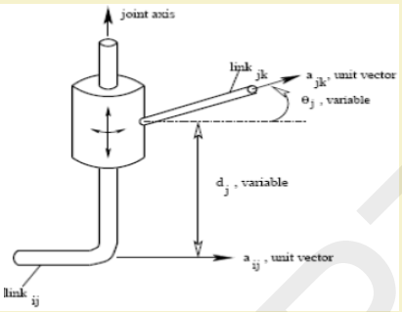
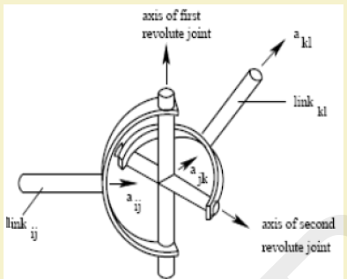



Slide 15
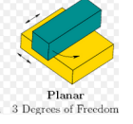
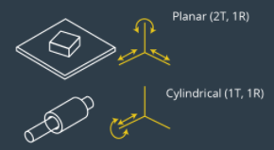

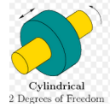
Other types of possible joints used are
Planar (one surface sliding over another surface)
Cylindrical (one link rotates about the other at 90° angle)
Spherical (one link can move with respect to the other in 3 dimensions)
Twist (2 links remains aligned along a straight line but one twists about the other around the link axis
Open Kinematic Chain – one end is connected to the base and the end effector is connected to free end of the last link.
Closed Kinematic chain – Parallel manipulators

Slide 16
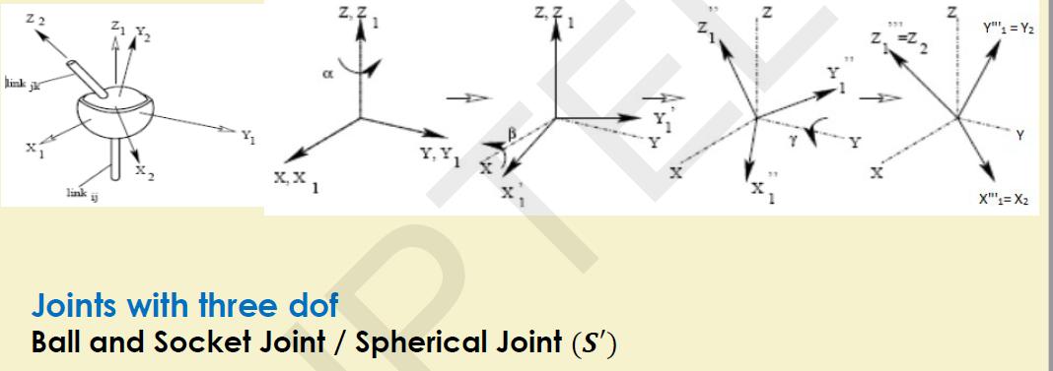
https://www.youtube.com/watch?v=zI64DyaRUvQ&t=22s

Slide 17
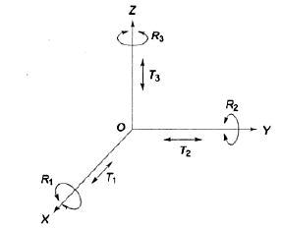
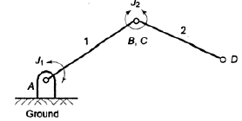
3. DoF
The number of independent movements that an object can perform in a 3D space is called DoF.
Rigid body free in space has 6dof.
In 3D space, 6 independent variables are required to specify the location (position and orientation)
In 2D space (a plane), an object has 3 dof – 2 translatory and 1 rotational
In open kinematic chain DoF is equal to the number of joints. (each joint has 1 dof)

Slide 18
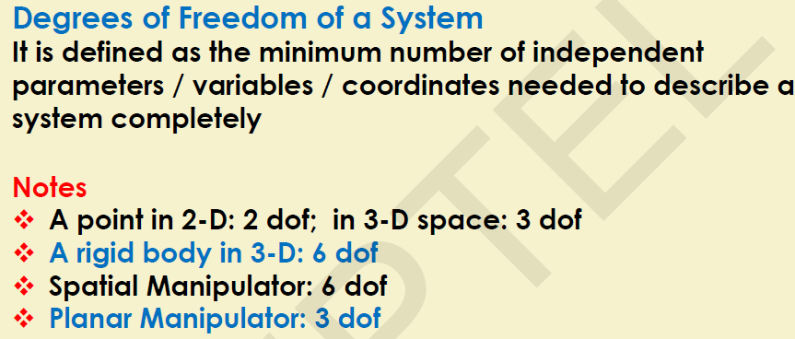

Slide 19
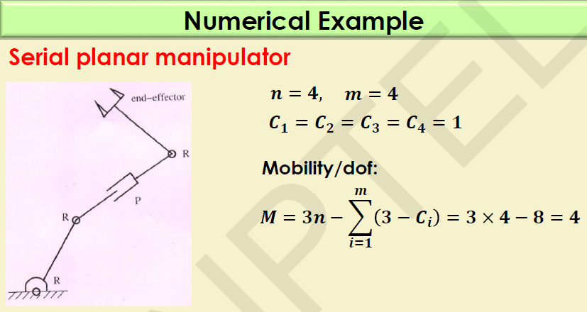
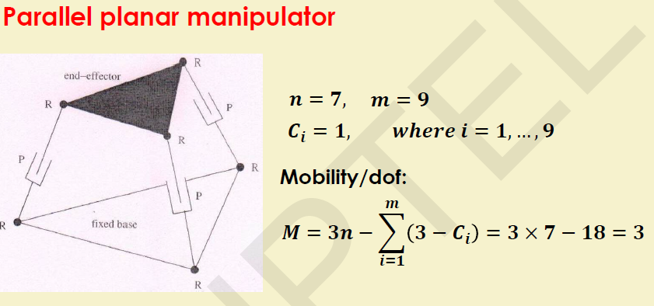

Slide 20
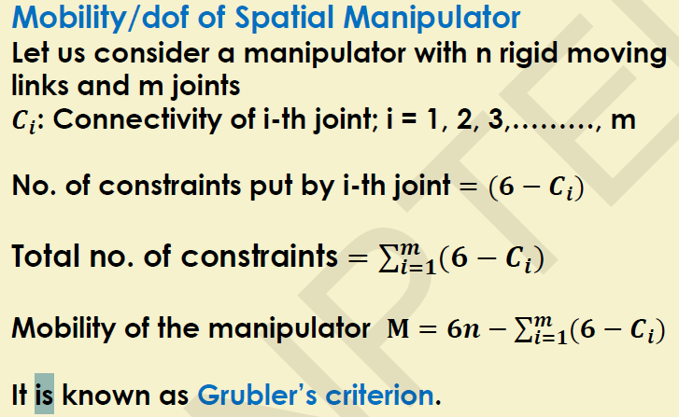
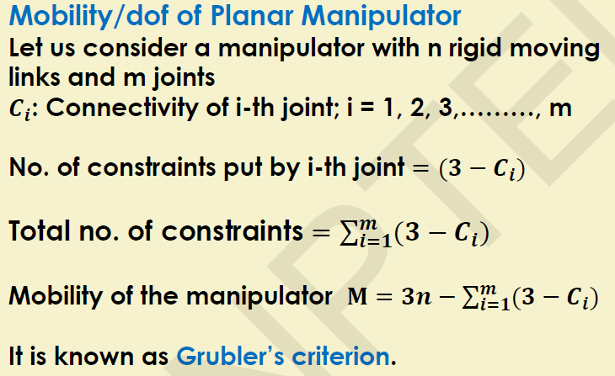
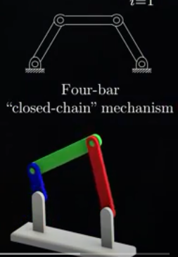
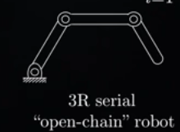

Slide 21
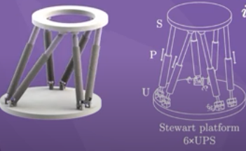
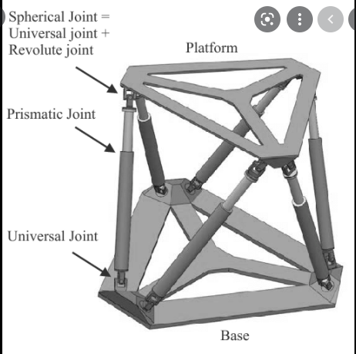
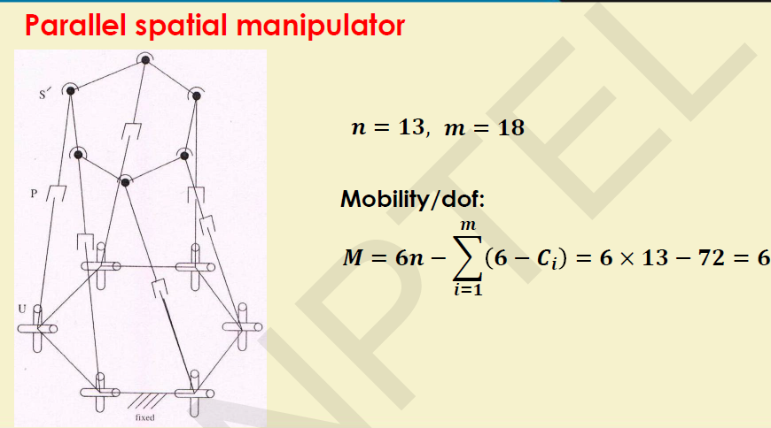
Human Arm???
https://www.youtube.com/watch?v=zI64DyaRUvQ&t=22s

Slide 22
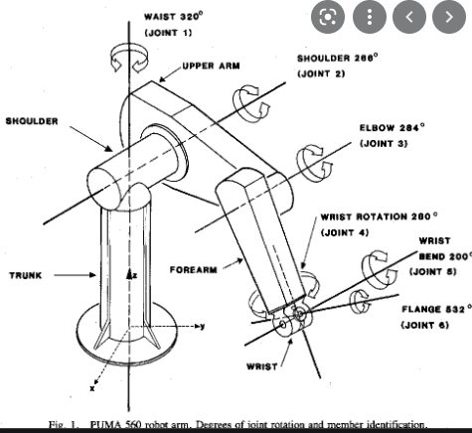


Slide 23
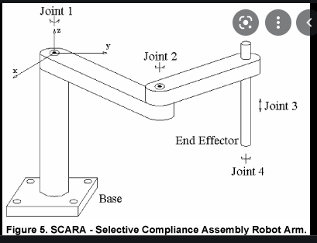
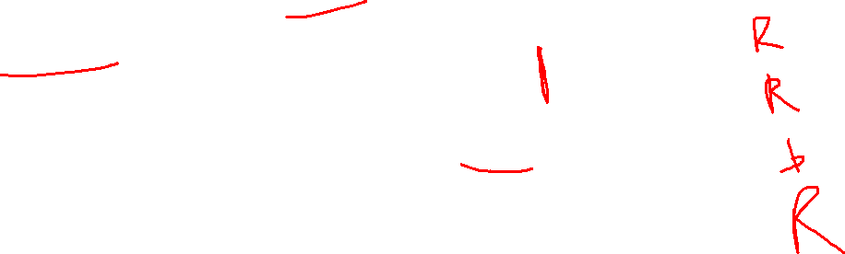

Slide 24
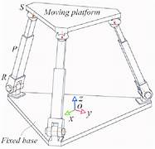
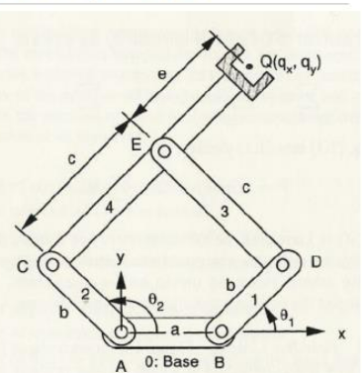

Slide 25
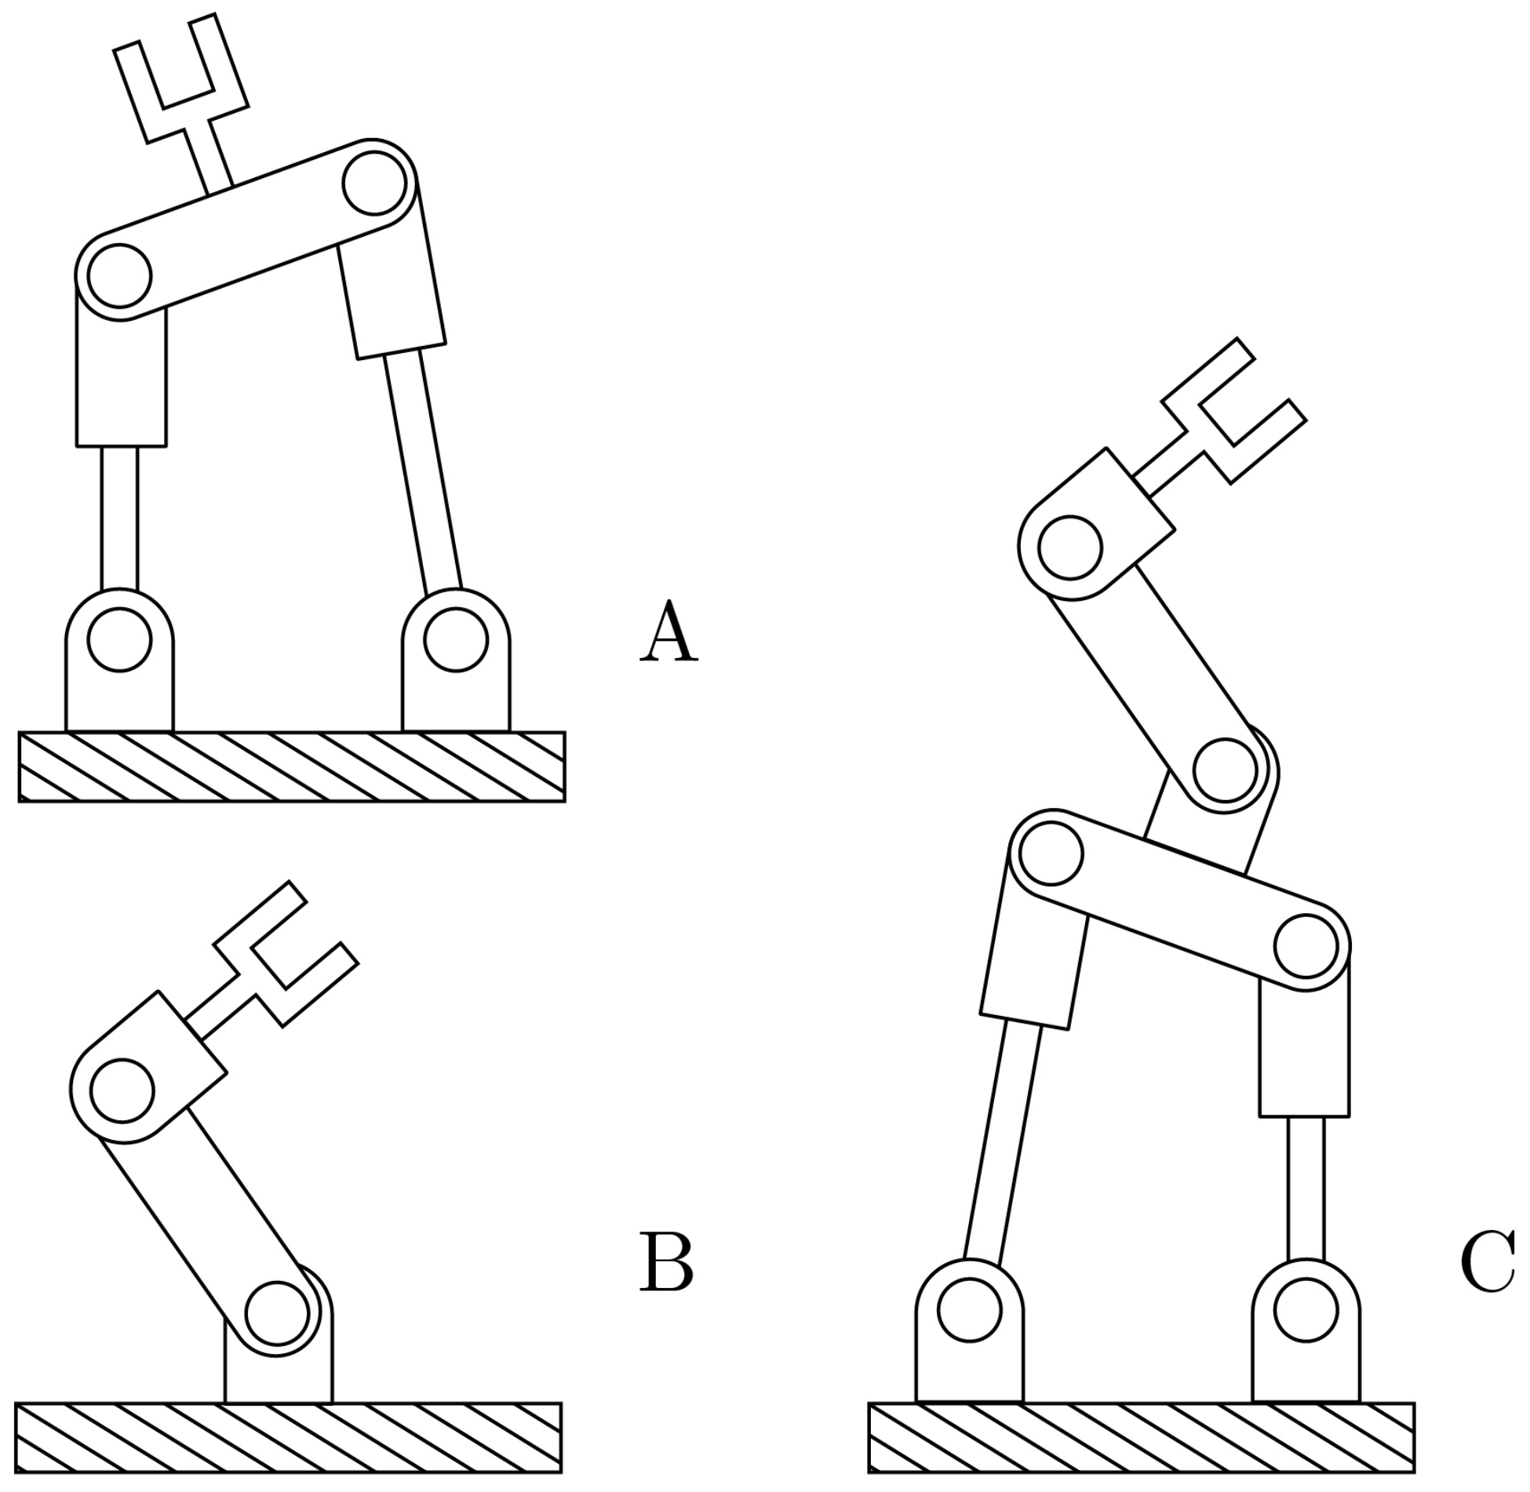

Slide 26
4. Required DoF in a Manipulator
Spatial Manipulator – to position and orientate a body freely in 3D space , a manipulator with 6 dof is required. Such Manipulator is called spatial manipulator
A manipulator with less than 6dof has constrained motion in 3D space
A planar manipulator can only sweep a 2D space or a plane and can have any number of dof.
Spatial manipulators with more than 6dof have surplus joints and are known as redundant manipulators. Extra dof may enhance the performance by adding to its dexterity.
Dexterity implies that manipulator can reach a subspace which is obstructed by objects , by the capability of going around these.
DoF of a manipulator are distributed into subassemblies of arm and wrist
Arm is used for positioning the end effector in space hence 3 dof is required. Remaining 3dof are provided in the wrist whose task is to orient the end effector.

Slide 27
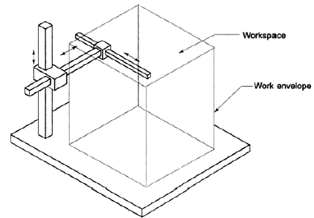
5. Arm configuration
Mechanics of the arm with 3dof depends on the type of 3 joints employed and their arrangement
Purpose of the arm is to position the wrist in 3D space and the arm has following characteristic requirements
Links are long enough to provide for maximum reach in the space
The design is mechanically robust because the arm has to bear not only the load of workpiece but also has to carry the wrist and the end effector
The four basic configurations are
Cartesian (rectangular)configuration
Cylindrical configuration
Polar (spherical) configuration
Articulated (revolute or jointed arm) configuration
Cartesian configuration
Simplest configuration with all 3P joints
Endpoint of the arm is capable of operating in cuboidal space called workspace
Workspace represents the portion of space around the base of the manipulator that
can be accessed by the arm endpoint.
Shape and size of the workspace depends on arm configuration, structure, dof,
Link size, design of joints.
Volume of the space swept is called work volume
Surface of the workspace describes the work envelope
It is not preferred for many applications due to limited manipulability even
though it has high precision and is easy to program. It gives large work volume but
has a low dexterity.

Slide 28
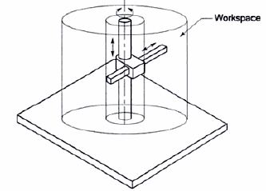
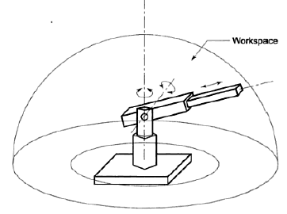
Cylindrical configuration RPP
Workspace is hollow cylinder
Offers good mechanical stiffness and the wrist positioning accuracy
decreases as the horizontal stroke increases.
It is suitable to access narrow horizontal configurations and hence useful for
machine loading operations
Polar (spherical) configuration RRP
Partial spherical shell space – work volume but PRR will not give spherical work volume
this allows manipulation of objects on the floor because its shoulder joint allows it end effector to go below base
Mechanical stiffness is lower than Cartesian and cylindrical wrist positioning accuracy decreases with increasing radial stroke
Industrial applications: Machining, spray painting

Slide 29
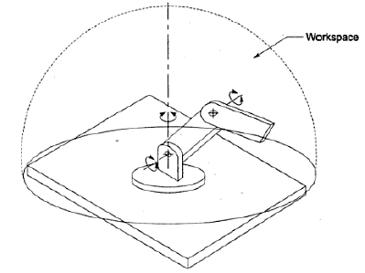
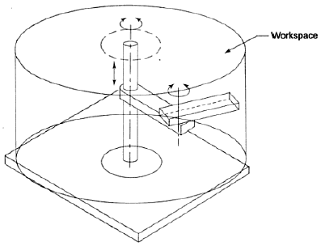
Articulated (revolute or jointed arm) configuration
Articulated arm is the type that best simulates a human arm and a manipulator
with this type of an arm is often referred to as anthropomorphic manipulator
Work volume is spherical shaped, arm endpoint can reach the base point
and below the base
Most dexterous one because all the joints are revolute, range of
industrial applications of this arm is wide
Other configurations
Characteristics of articulated and cylindrical configurations combined to form SCARA
It has vertical major axis rotations such that gravitational load, coriolis and
centrifugal forces do not stress the structure as much as they would if the axes
were horizontal.
This advantage is very important at high speeds and high precision, this
configuration provides high stiffness to arm in vertical region and high
compliance in horizontal plane

Slide 30
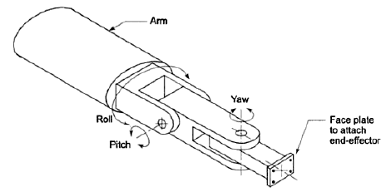
6. Wrist configuration
Arm configurations carry and position the wrist, which is the second part of manipulator that is attached to the endpoint of the arm.
Wrist – to orientate the end effector to perform the task properly.
It requires only rotary joints because its sole purpose is to orientate
3 dof wrist permitting rotation about 3 perpendicular axes provides for
Roll (motion in a plane perpendicular to end of the arm)
Pitch (motion in vertical plane passing through the arm)
Yaw (motion in a horizontal plane that also passes through the arm)
This type of wrist is called RPY wrist
A wrist with highest dexterity is one where 3 rotary joint axes intersect at a point
https://www.youtube.com/watch?v=EjvdpkX9fD8

Slide 31
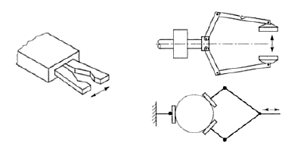
7. End effector
it is external to the manipulator
According to the task to be executed, different end effectors can be attached to the end of the wrist
Grippers
Tools
Grippers are to grasp or hold the workpiece during work cycle
Applications: material handling, machine loading-unloading, palletizing,
Employ mechanical grasping or other alternative ways such as magnetic, vacuum, bellows for holding objects
For many tasks performed by manipulator, end effector is a tool.
For ex, cutting tool, a drill, welding torch, spray gun or a screw driver is the end effector for machining, welding, painting or assembly task mounted at the wrist.
Sometimes gripper maybe used to hold the tool instead of workpiece

Slide 32

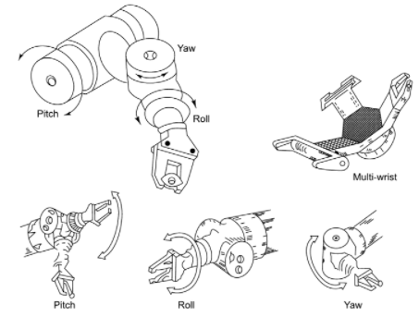
RPY Wrist
Wrist – to orientate the end effector to perform the task properly.
It requires only rotary joints because its sole purpose is to orientate
3 dof wrist permitting rotation about 3 perpendicular axes provides for
Roll (motion in a plane perpendicular to end of the arm) – rotates the tool about its center axis
Pitch (motion in vertical plane passing through the arm) – moves the tool vertically up and down
Yaw (motion in a horizontal plane that also passes through the arm) – turns the tool left and right
This type of wrist is called RPY wrist
https://www.youtube.com/watch?v=FORcPhBaa50 (from 1.09min)
https://www.youtube.com/watch?v=EjvdpkX9fD8 (from 1.42min)

Slide 33
